Slide 1


VEMANA INSTITUE OF TECHNOLOGY (Affiliated to VTU and approved by AICTE) #1, Mahayogi Vemana road, Koramangala, Bengaluru-560034
DEPARTMENT OF COMPUTER SCIENCE & ENGINEERING
Internship Seminar Presentation
On
“House Price Prediction”
Presented By:
KOMAL BHAT
1VI19CS046
VIII Sem ‘A’ Section
Department of CSE, Vemana IT
Guided By:
Dr Kantharaju H C
Associate Professor
Department of CSE, Vemana IT

Slide 2
Contents
2022 - 2023
Abstract
Introduction
Organization overview
Implementation/Results
Conclusion
Bibliography

Slide 3
Abstract
2022 - 2023
House price prediction is crucial for the establishment of real estate policies..
The aim of this project is to employ actual transaction data and advanced machine learning models to predict real estate prices more accurately.
Machine learning-based models offer a substantial and feasible approach to forecast real estate prices, leveraging their ability to analyze large datasets, identify complex patterns, and make accurate predictions.
By analyzing features such as location, area type and property size, the models can capture the underlying factors that influence house prices in Bangalore.

Slide 4

Organization overview
2022 - 2023
Vivarttana is formed by indigenous & innovative Team of Corporate and Educationists.
It firmly believes in setting a benchmark in Software Applications & Product Development and transforming individuals to build their passionate dream career.
Their motto is to explore & address various Socio-Economic Business Problems with their unique solutions & in Education wing to connect “Right talent” to the “Ample Opportunities”.

Slide 5

Introduction
2022 - 2023
A platform where house buyer can get proper information regarding the house price.
House price depends on many factors like age of the house, number of bedrooms, area population etc.
Data can be extracted from the web or any application and saved to a database or CSV file.
Converting the raw data into a clean data set which meant as Data Cleaning.
Various algorithms like linear regression ,decision tree are applied to predict the accuracy of house prices.

Slide 6
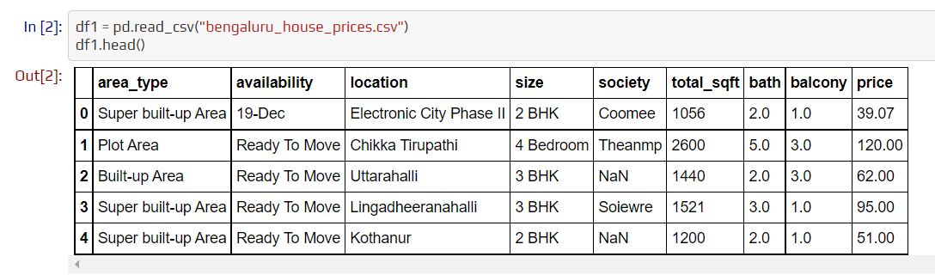
Results
2022 - 2023
In this, read_csv is used to read CSV files and head() function is used to obtain the first n rows. This function retrieves the object's first n rows based on location.

Slide 7
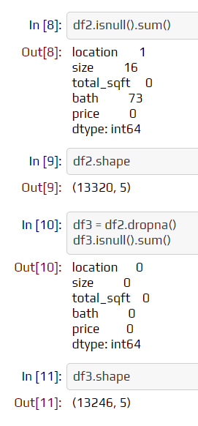
Results
2022 - 2023
Data cleaning is performed where isnull and dropna functions are used to check and remove the missing values respectively.

Slide 8
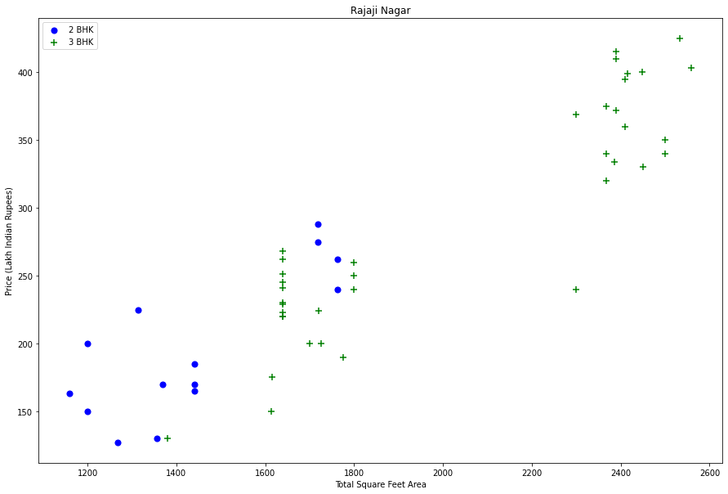
Results
Data visualizing for a given location to show, how the 2 BHK and 3 BHK property prices look like..

Slide 9
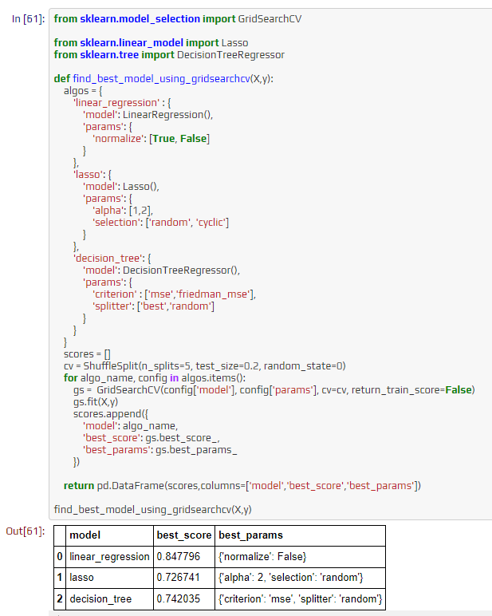
Results
As in the output ,linear regression is considered as best model to price of house.

Slide 10
Conclusion
2022 - 2023
With several characteristics, the suggested method predicts the property price in Bangalore.
We experimented with different Machine Learning algorithms to get the best model.
When compared to all other algorithms, Linear Regression achieved the greatest performance in terms of predictive accuracy.
Most of the organizations are already implementing machine learning technology as it generates more accurate and consistent processes that are less prone to errors.

Slide 11
Bibliography
2022 - 2023
https://www.kaggle.com/code/bangalore-house-price-prediction-model
https://towardsdatascience.com/predicting-house-prices-with-linear-regression-machine-learning.
https://www.dataquest.io/blog/top-10-machine-learning-algorithms-for-beginners/

Slide 12
THANK YOU

